Slide 1
Cloud Computing: Database as a Service Part I
Vijay Dialani, PhD
Boise State University
vijaydialani@boisestate.edu
©All rights reserved by the author

Slide 2
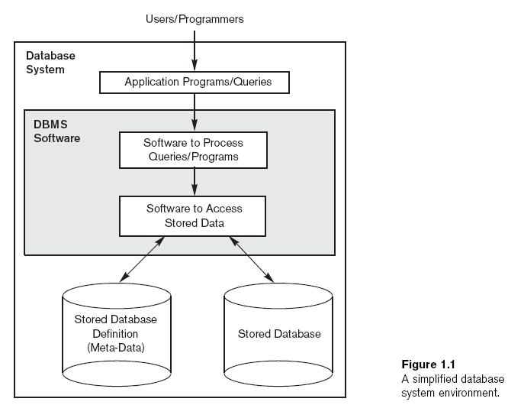
What is a Database?
A database is an organized collection of data. The data are typically organized to model aspects of reality in a way that supports processes requiring information.
Notes:
Define Database and also the properties of ACID and transactions.

Slide 3
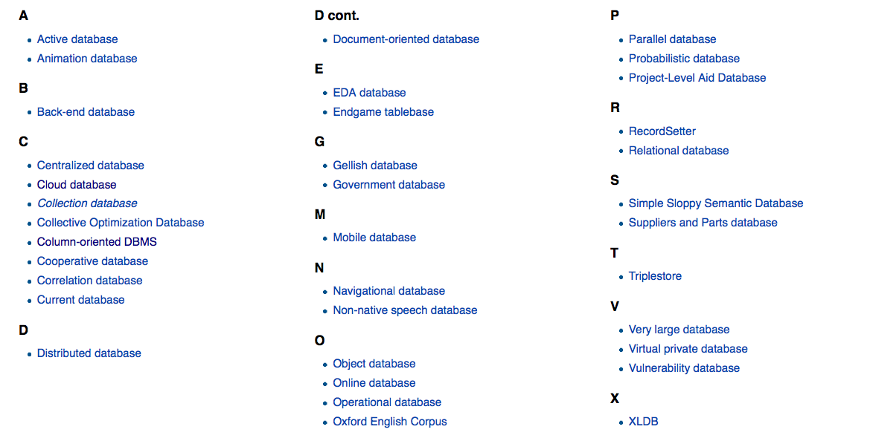
Types of Databases
Notes:
Introduce Hierarchical, Relational, Document and Graph Databases

Slide 4
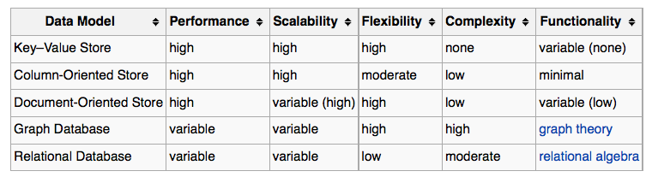
SQL and NOSQL Databases
Notes:
Describe how these databases are different. OLTP v/s OLAP. Append only data and read/write data.

Slide 5
NOTE
Rest of the presentation is about creating Database as a service using
Relational Data Model
Part II will discuss NOSQL implementations
Notes:
Describe how these databases are different. OLTP v/s OLAP. Append only data and read/write data.

Slide 6
Data Model
Notes:
Enumerate interaction between the data model and how it could help / obstruct parallel processing

Slide 7
Data Model -> To Physical Database
Notes:
Enumerate interaction between the data model and how it could help / obstruct parallel processing

Slide 8
SQL databases conceptual view

Slide 9
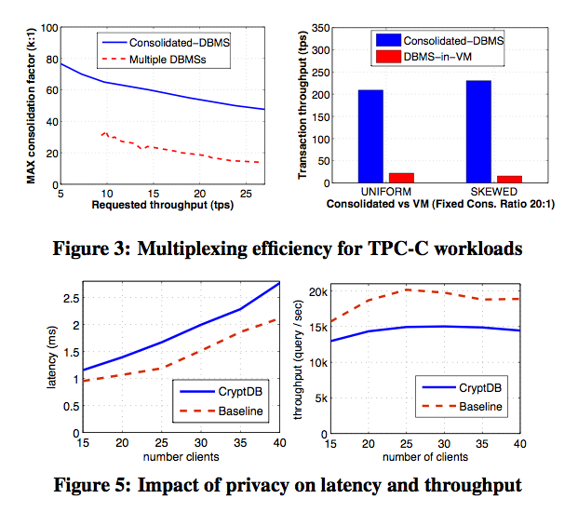
Relational Cloud
Relational Cloud: A Database-as-a-Service for the Cloud
Carlo Curino et.al. http://people.csail.mit.edu/nickolai/papers/curino-relcloud-cidr )

Slide 10
SQL databases Partitioning Schemes
Problem I: Given a data model, we have too many number of rows, but each query operates on a range of rows.
Solution:
For a share nothing architecture, we can partition the data
Range partitioning: Selects a partition by determining if the partitioning key is inside a
certain range. An example could be a partition for all rows where the column zipcode
has a value between 70000 and 79999.
List partitioning: A partition is assigned a list of values. If the partitioning key has one
of these values, the partition is chosen. For example all rows where the column
Country is either Iceland, Norway, Sweden, Finland or Denmark could
build a partition for the Nordic countries.
Hash partitioning The value of a hash function determines membership in a partition.
Assuming there are four partitions, the hash function could return a value from 0 to 3.
Composite partitioning allows for certain combinations of the above partitioning schemes,
by for example first applying a range partitioning and then a hash partitioning.

Slide 11
Column Stores
Problem II: Given a data model and instance data, the query time varies because of the query optimizer introduced variance
Solution:
Use column stores – C-Store: A Column-oriented DBMS, Michael Stonebraker et.al.
Lets Review the Paper.

Slide 12
Column Stores
Problem III: Given a database, how do I ensure that the database is secured.
Solution:
Operate on Encrypted data – CryptDB: Protecting Confidentiality with Encrypted Query Processing, Popa et.al

Slide 13
Column Stores
Problem IV: Not all the items in the database are queried equally, how do I create the dynamic partitioning and load balancing
Solution:
Schism: a Workload-Driven Approach to Database Replication and Partitioning by Carlo Curino et.al.

Slide 14
Column Stores
Problem V: A lot of my data is shared between applications
Solution:
Use Multi-tenant databases:
Ruminations on Multi-Tenant Databases
http://www.db.in.tum.de/research/publications/conferences/BTW2007-mtd.pdf

Slide 15
Questions and Answers

